Slide 1
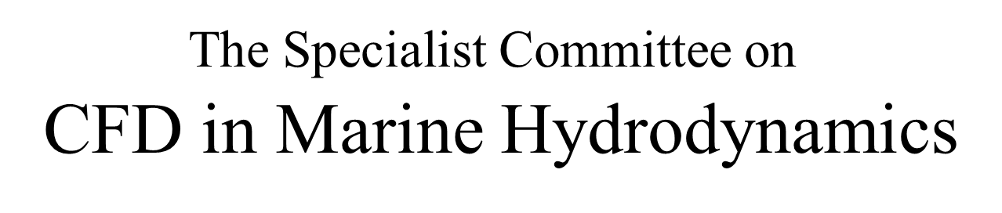
Final Report

Slide 2
CFD committee members & meetings
  Chairman: Takanori Hino Yokohama National University, Japan
  Secretary: Pablo M. Carrica IIHR, The University of Iowa, USA
    Riccardo Broglia INSEAN-CNR, Italy
    Peter Bull QinetiQ, UK
    Sung-Eun Kim NSWC-CD, USA
    Da-Qing Li SSPA, Sweden
    Shin-Hyun Rhee Seoul National University, South Korea
    Ilkka Saisto VTT, Finland
    Ignazio Maria Viola The University of Edinburgh, UK
    Decheng Wan Shanghai Jiao Tong University, China
  26 ~ 27 March 2012 Yokohama, Japan
  8 ~ 9 November 2012 Bethesda (MD), USA
  10 ~ 11 June 2013 Jeju, South Korea
  16 ~ 17 January 2014 Portsmouth, UK

Slide 3
Structure of the CFD report
Steep and Breaking waves
Steady and Unsteady Flow Field
New Directions
New Modeling Techniques
Real-time CFD
Wake scaling
Verification and Validation
Trends in Naval Architecture Applications
Resistance
Propulsion
Propellers
Seakeeping
Manoeuvring
Ocean Engineering
Conclusions and recommendations

Slide 4
2. Steep and Breaking Waves
Proper modeling of steep and breaking waves is important because
Affects overall free surface topology
Its role on air and bubble entrainment
Has direct effect on several Naval Architecture and Marine Engineering phenomena
  Modeling of a seaway for seakeeping and maneuvering simulations
  Computation of impact loads on platforms and other objects

Slide 5
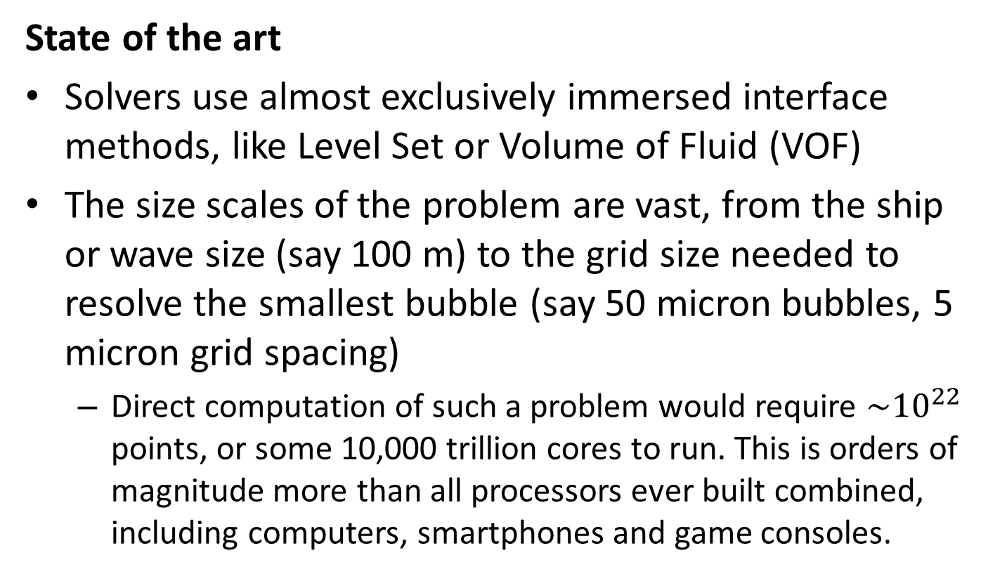
State of the art
Solvers use almost exclusively immersed interface methods, like Level Set or Volume of Fluid (VOF)
The size scales of the problem are vast, from the ship or wave size (say 100 m) to the grid size needed to resolve the smallest bubble (say 50 micron bubbles, 5 micron grid spacing)
  Direct computation of such a problem would require $\sim {10}^{22}$ points, or some 10,000 trillion cores to run. This is orders of magnitude more than all processors ever built combined, including computers, smartphones and game consoles.

Slide 6
State of the art
Seaway simulations
  Direct simulations using VOF and data assimilation of JONSWAP HOS results provides the best resolution to date (Dommermuth et al. 2013)
Breaking wave simulations
  Doable ignoring the smallest scales
  (bubbles)
  Typically billions of points are needed
  to resolve the most important scales
  Overturning waves are resolved in ship
  computations at scales of several centimeters

Slide 7
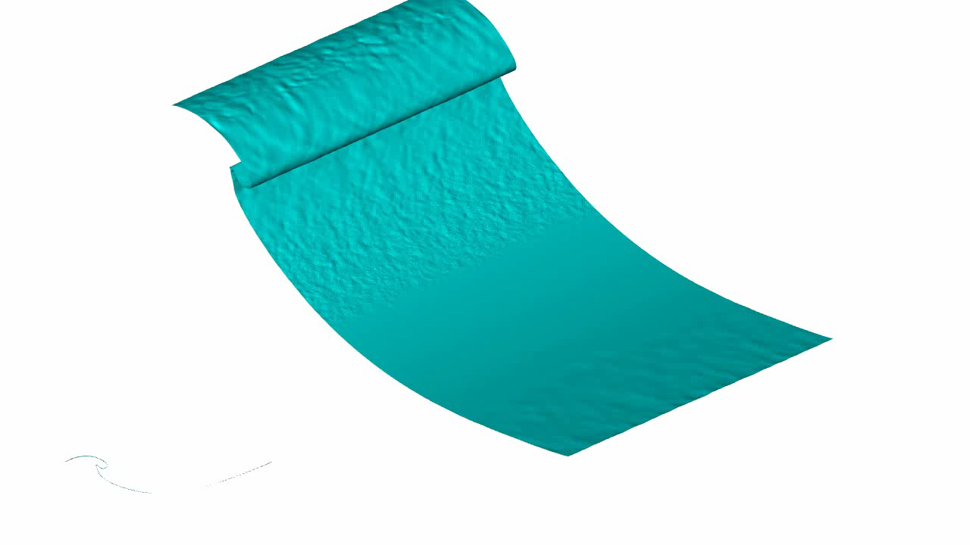
Example breaking wave: 3.2 billion grid points, Wang, Yang, Stern, SNH 2014.

Slide 8
State of the art
Extreme waves
  Can be generated in a towing tank by focusing linear waves
  A similar technique can be used in CFD to produce large waves
    Hurricane Camille and three sisters event (Mousaviraad et al. 2008)
Summary
Steep and breaking wave simulations are feasible (but costly) with today’s computers and CFD techniques. Direct simulation of bubble entrainment is limited to small domains.

Slide 9
3. Steady and Unsteady Flow Prediction
Most flow fields in practical marine hydrodynamics are unsteady.
Steady Flows in Reynolds averaged sense
  Resistance in calm water
  Steady drift or steady turning
  Self-Propulsion with a body force propeller model
Unsteady Flow Examples
  Self-propulsion due to propeller rotation
  Ship motions, ambient waves, or motions of appendages and propellers.
  Ambient waves and the body motions, the vortex shedding and the vortex induced motions in ocean engineering applications

Slide 10
Numerical procedures for steady flows such as resistance predictions of ships
  Artificial compressibility approach
  SIMPLE
Numerical procedures for unsteady flows
  the mass conservation must be satisfied at each time step --- the pressure Poisson Eq.
  the nonlinearity of the coupled system of equations.
  Longer CPU times than steady state cases

Slide 11
Discretization schemes in time.
  First order time integration schemes introduce significant errors both for temporal and spatial accuracy in unsteady computations.
  First order scheme is OK for steady state solutions.
  Higher-order schemes are recommended for unsteady flows.
Time step size
  Stability considerations.
  Implicit schemes allow larger time steps and are preferred
  Requirements from the flow physics
    Period of incident waves.
    Manoeuvring motions, propeller rotations

Slide 12
Practical applications of steady and unsteady flow predictions in SIMMAN 2008 Workshop and Gothenburg 2010 Workshop on CFD
  In summary, for ship hydrodynamics applications, unsteady flow solvers are most frequently adopted with pressure correction method or direct method for velocity-pressure coupling. Time discretization schemes typically used are first-order Euler implicit scheme for steady flows and the three-step backward method for unsteady flows. The other choices for steady flow problems are steady solvers with SIMPLE or artificial compressibility.

Slide 13
4. New Directions
4.1 New modeling techniques
LES (Large-eddy simulation)
LES is perceived as an effective tool for tackling flows involving massive separation and/or turbulent flow structures that are especially difficult for RANS models.
As available computing capacity increases, computational fluid dynamics (CFD) researchers and practitioners are moving towards the use of large eddy simulation (LES) as a higher fidelity alternative to RANS, but still incapable to handle thin boundary layers.

Slide 14
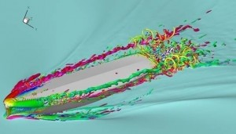
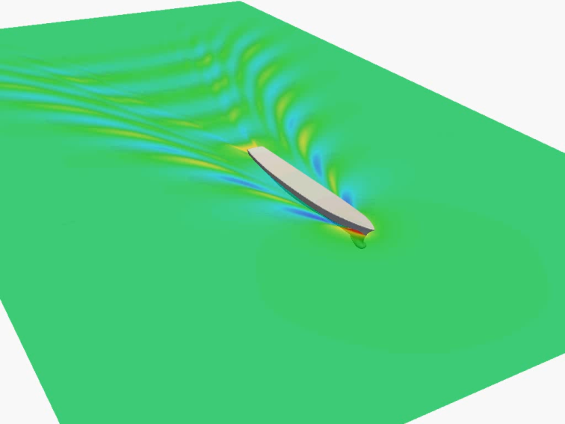
DES (Detached-Eddy Simulation)
Practical alternatives that seek to leverage the best qualities of RANS and LES are the so-called hybrid RANS/LES methods, for example detached eddy simulation (DES). The RANS and LES regions may be delineated using a zonal scheme or a smooth blending parameter.
Wave-making flows by LES
Wave-making flows by DES

Slide 15
Lagrangian Particle Methods
In Lagrangian particle methods, no computational grids are introduced in the domain (meshless character) and the flow evolution is described following the motion of a set of fluid particles (Lagrangian character).
It has been applied to the study of some internal (sloshing and dam-break problem) and external flows (breaking and post-breaking evolution of bores propagation toward beaches and bow breaking waves generated by fast slender vessels).

Slide 16
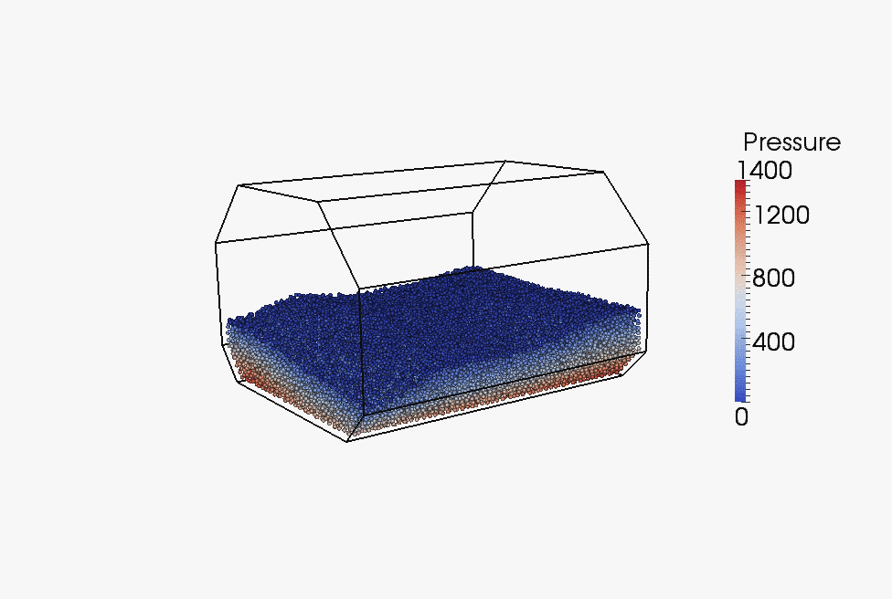
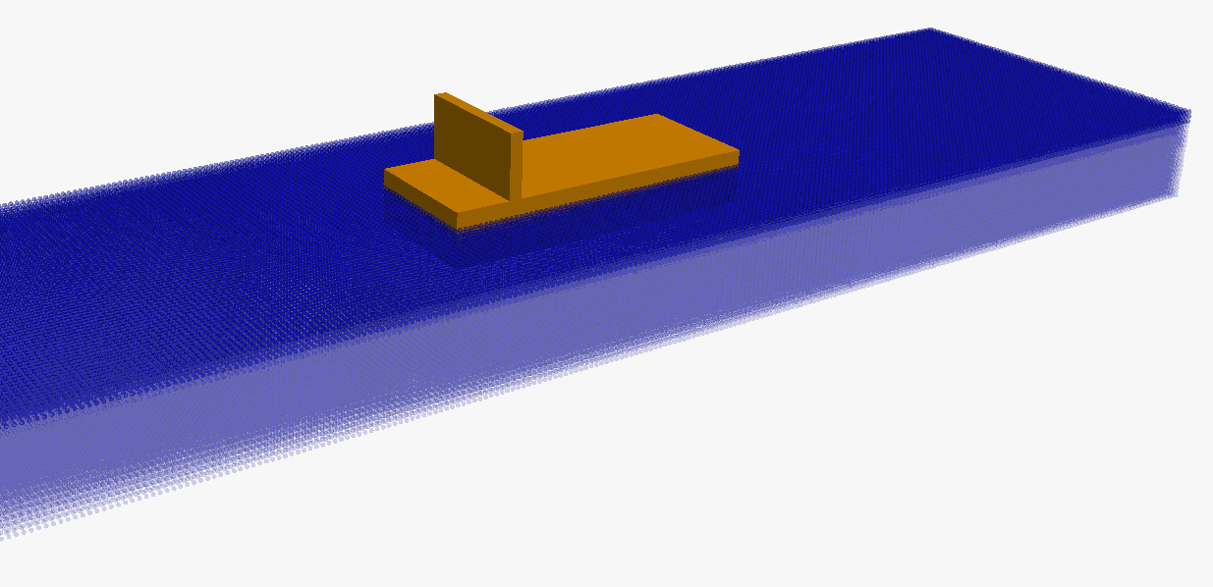
Lagrangian Particle Methods
There are two major Lagrangian particle methods: SPH (Smoothed Particle Hydrodynamics) and MPS (Moving Particle Semi-implicit) methods. Both methods use particles and calculate fluid behavior based on Navier-Stokes equation; however, the basic idea is different.
Green water flows by SPH
Sloshing flows by MPS

Slide 17
Open Source Programming
Open source code is typically created as a collaborative effort in which programmers improve upon the code and share the changes within the community.
Not only the features of open source codes are comparable to the commercial CFD software, they also provide a general and open platform for developing new numerical methods and tools.
In recent years, open source codes, for example, OpenFOAM, FreeShip, Gerris, DUNS, have become popular, OpenFOAM is among the best.

Slide 18
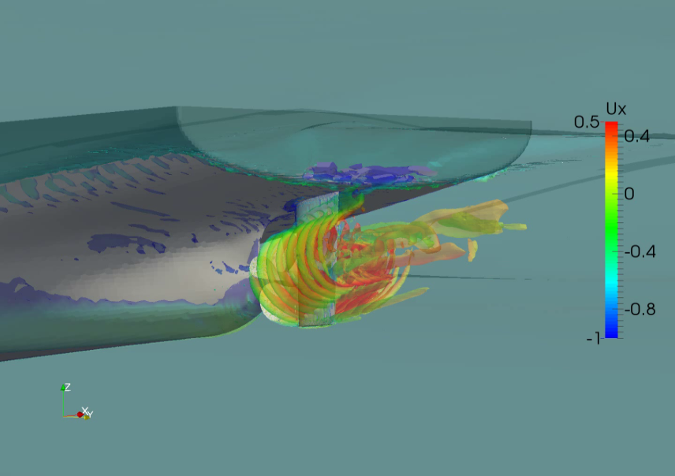
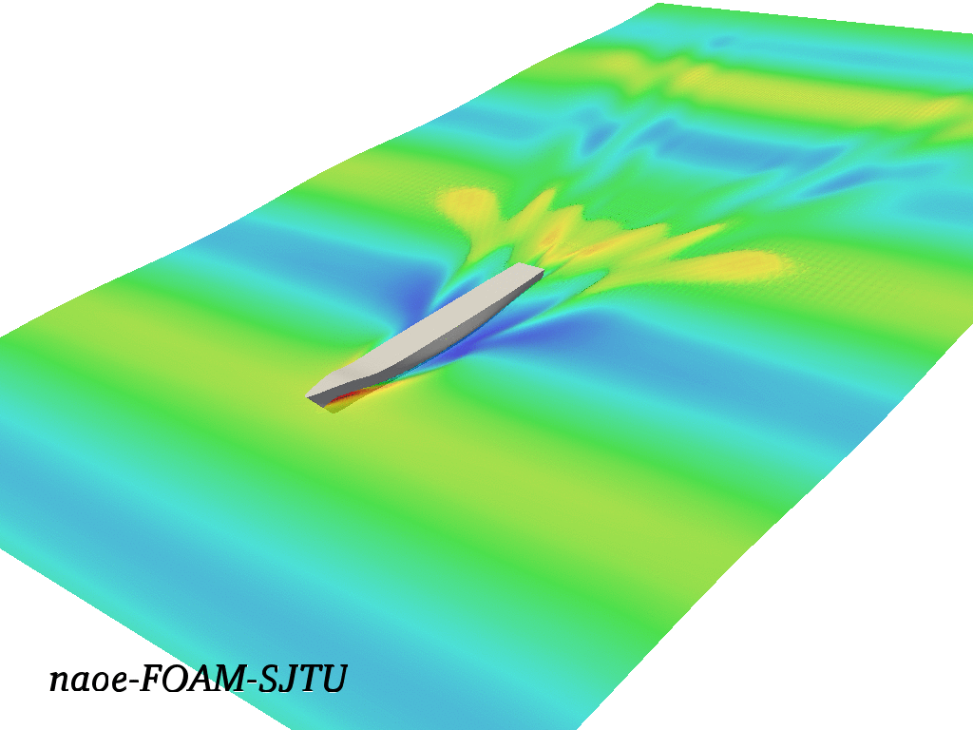
Open Source Programming
OpenFOAM is an object oriented C++ set of libraries for solving various partial differential equations using the finite volume method. Because of its object-oriented construction, users can implement codes for their own applications. For example, a dynamic overset grid capability has been implemented in OpenFOAM aiming at ship flows for seakeeping, manoeuvring and ship-ship interaction.
Ship motion in waves
Ship self-propulsion

Slide 19
4.2 Real-time CFD
The feasibility of real-time CFD analyses linked to manoeuvring simulators was examined.
  Pinkster and Bhawsika (2013) constructed a system which combines a real-time potential flow computation and a manoeuvring simulator.
It was concluded that the use of real-time CFD methods linked to manoeuvring simulators are still beyond the capability of current computing environments.
  In order to provide the hydrodynamic forces and moments to manoeuvring simulators in real time, CFD must run at least 2500 times faster than currently possible.

Slide 20
5. Wake scaling & full-scale wakes
Wake scaling is needed
For propeller design
For correct prediction of cavitation and propeller-induced pressure pulses in a cavitation tunnel
Literature survey of CFD applications relevant to wake
Used to assist developing wake scaling (scarce)
Validation with model scale nominal wake (abundant)
Prediction of full scale nominal wake (some)
Validation with full scale wake data (rare)

Slide 21
Validation of nominal wake model scale (summary of G2010 WS)
The overall agreement between computations and experiments in terms of wake patterns at the propeller plane was fairly good;
The characteristic features of the bilge vortices were captured by the majority of CFD solvers;
The turbulence model has a profound influence on the accuracy of local flow structures. The flow details predicted by the advanced turbulence models like Reynolds Stress Model (RSM) and Explicit Algebraic Stress Model (EASM) show clearly better agreement with measured data than simpler isotropic eddy-viscosity models, mostly for the wake field of full form ships that have strong anisotropy in Reynolds stresses and hook shape iso-contours of the axial velocity;
3~4 million grid points on half hull with a 2nd order discretization scheme seem sufficient to make a good prediction at model scale (without appendages or free surface effects).

Slide 22
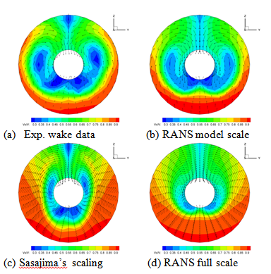
Example: CFD vs. wake scaling method
Gaggero S., Villa, D., Viviani, M. Rizzuto, E. “Ship wake scaling and effect on propeller performances”. (2013)
full scale wake pattern scaled by Sasajima’s scaling method different from the direct RANS prediction
bilge vortex by scaling method is stronger and appears in a different location as compared with the RANS method

Slide 23
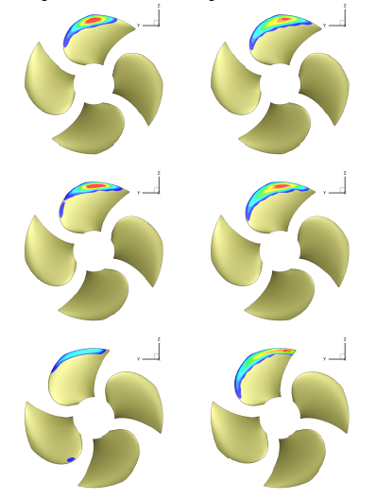
Example: CFD vs. wake scaling method
Wake difference may result in:
Difference in pitch distribution
Different cavitation behaviour
Different resultant fluctuating force
Scaling method vs. RANS full scale

Slide 24
Full-scale nominal wake by RANS
Challenges for full scale wake calculations are the extremely high aspect ratio of near-wall grid cells, large grid size and lack of validation of turbulence models at full scale.
Current practice is to perform some form of validation study at model scale, then apply the same grid strategy, discretization scheme and turbulence model for full scale calculation without further validation.
Following the 27th ITTC Practical Guideline for RANS Calculation of Nominal Wake (7.5-03-03-02), RANS methods can be a useful tool to deal with scale effects in wake field.

Slide 25
6. Validation and verification
Verification is the procedure to estimate the numerical error and uncertainty of computed results.
Validation aims at assessing the choice of the numerical model as a representation of reality.
  Verification :“solving the equations right”
  Validation :“solving the right equations”. (Roache 1997)
Various Procedures and Standards
  ASME (ASME V&V10, V&V20), AIAA (AIAA G-077-1998)
  ITTC guidelines on V&V (7.5-03-01-01, 7.5-03-01-02, 7.5-03-01-03, 7.5-03-01-04).
A review in V&V for ship hydrodynamics
  Roache (1997), Eça and Hoekstra (2012), Larsson et al. (2014).

Slide 26
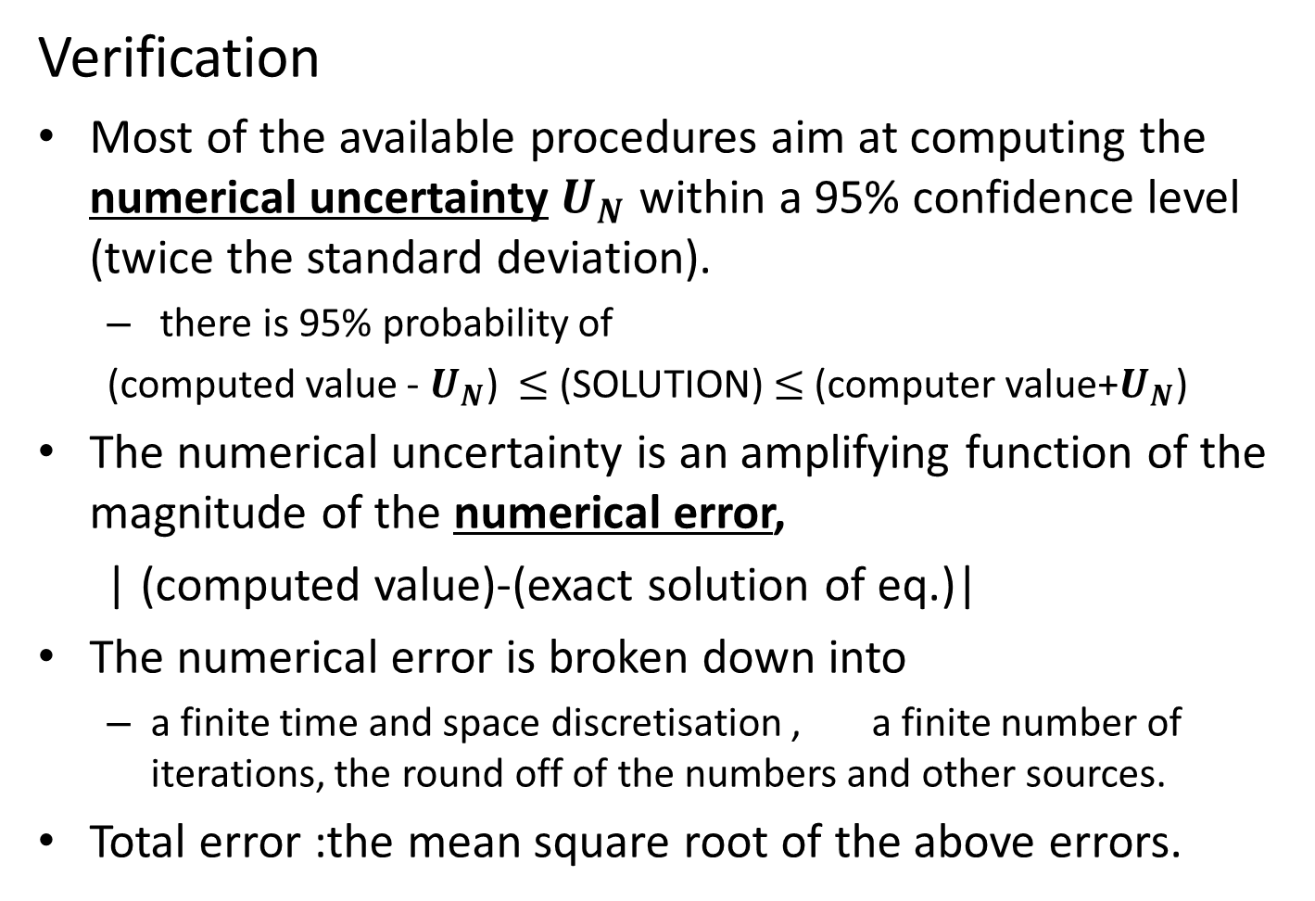
Verification
Most of the available procedures aim at computing the numerical uncertainty $U_{N}$ within a 95% confidence level (twice the standard deviation).
  there is 95% probability of
  (computed value - $U_{N}$) $≤$ (SOLUTION) $≤$ (computer value+$U_{N}$)
The numerical uncertainty is an amplifying function of the magnitude of the numerical error,
| (computed value)-(exact solution of eq.)|
The numerical error is broken down into
  a finite time and space discretisation , a finite number of iterations, the round off of the numbers and other sources.
Total error :the mean square root of the above errors.

Slide 27
Verification Methods
Different extrapolation methods to obtain the simulation result with a null error.
  Grid Convergence Index (GCI) , Roache (1998,2009)
  Factor of Safety (FS), Xing and Stern (2010)
  Least Square Root (LSR), Eca et al. (2010)
No method proven superior to the others.

Slide 28
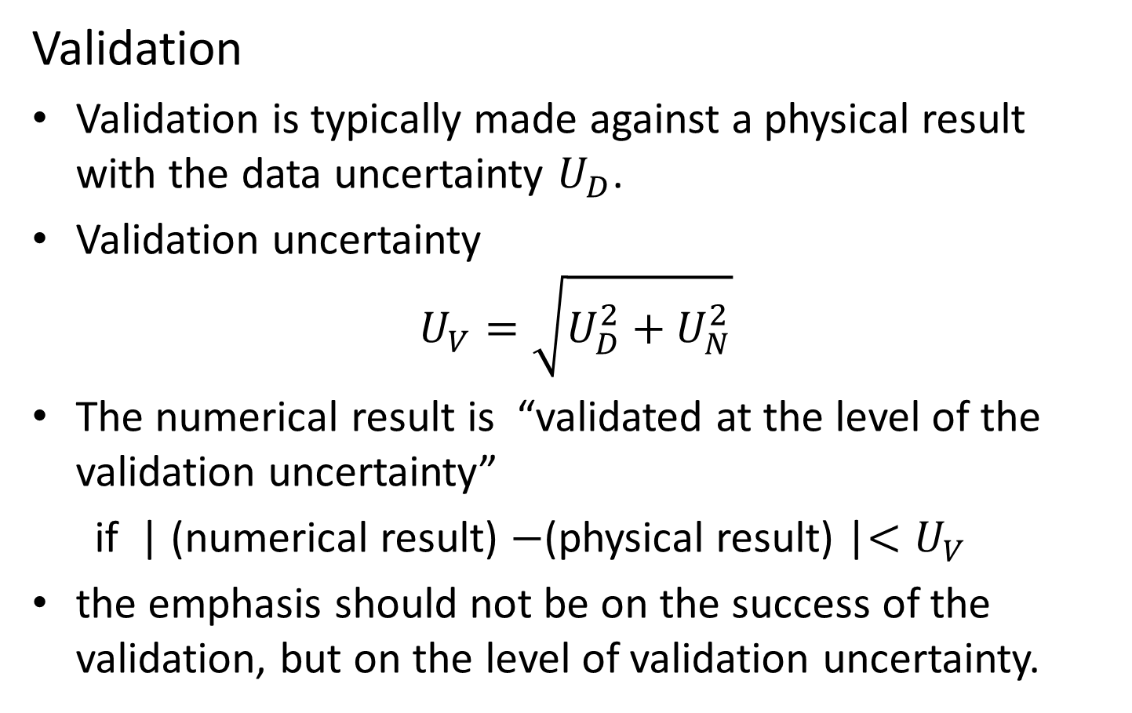
Validation
Validation is typically made against a physical result with the data uncertainty $U_{D}$.
Validation uncertainty
$$U_{V}=\sqrt{U_{D}^{2}+U_{N}^{2}}$$
The numerical result is “validated at the level of the validation uncertainty”
if | (numerical result) $−$(physical result) |$<U_{V}$
the emphasis should not be on the success of the validation, but on the level of validation uncertainty.

Slide 29
V&V general remarks
One of the most important challenges of V&V is to become a common practice for the industry.
CFD results are approximations and not exact solutions, they are meaningless without knowledge of the associated uncertainty.
Future research will allow developing more intuitive and less computationally demanding methods.

Slide 30
7. Trends in Naval Architecture Applications
7.1 Resistance
Overall trends
  Ever-increasing size of computational grids (e.g., tens of millions elements or grid points) driving down numerical discretization error
  Proliferation of unstructured grids for ”industrial” applications
  Easy accessibility of high performance computing - the CFD World is getting ”flat”!
  The landscape of CFD world is dominated by commercial software packages and in-house codes tailored to ship applications.
  Combination of finite-volume method on unstructured grids and “projection methods” or “artificial compressibility” are predominantly used.
  Two-equation-based, linear and non-linear isotropic eddy-viscosity turbulence models are the workhorse in spite of their well-known limitations.

Slide 31
Emerging trends
  Advent of open-source codes (e.g., OpenFOAM, Gerris, SU2) that might change the landscape of CFD in coming years
    OSCAR efforts mainly driven by EU countries
    Customized codes based on OpenFOAM
  Marriage of RANS methods with potential-flow theory, e.g., velocity decomposition method by Rosemurgy et al. (2011)
    Smaller computational domain
    Free-surface effects (boundary conditions) taken care of by potential-flow theory
  RANS predictions for full-scale ships
    Near-wall grid-resolution requirement for ultra high Reynolds number (e.g., Re = 10⁹ ) alleviated by use of wall functions
  Hybrid RANS-LES
    Suffer from log-layer mismatch, resolved stress depletion, and grid-induced separation
    Not ready yet for prime-time use for resistance predictions

Slide 32
  Summary and conclusions from 2010 Gothenburg workshop (Larsson et al., 2014)
  For resistance, the mean comparison error and the standard deviation are mere 0.1% and 2.1%, respectively, which are much smaller than those at the previous workshops.
  For sinkage and trim at above Fr = 0.2, the mean comparison error and the standard deviation are 4% and 8%, respectively, much smaller than those at the last workshop.
  The statistical variance (scatter) of all the predictions submitted by the participants was substantially smaller than had been found in the previous workshops in 2000 and 2005.
  The consistency between the order of accuracy from the grid refinement studies and the claimed formal order of accuracy was largely lacking.

Slide 33
7.2 Propulsion
Main issues
  Propeller-hull interaction on a ship in steady, straight-ahead cruise
  The main question is how to rerpesent the effects of rotating propeller(s)
  Propulsive parameters such as effective wake and thrust deduction
  Implications of propeller-hull inetraction on hull vibration and propeller noise
  Emerging trends
  More sophisticated actuator-disk models that take into account more physics
  BEM representation of propeller and coupling of BEM and RANS
  Explicit (direct) inclusion of rotating propellers(s) using sliding grids or overset grids
    Computationally intensive but the key physics directly resolved

Slide 34
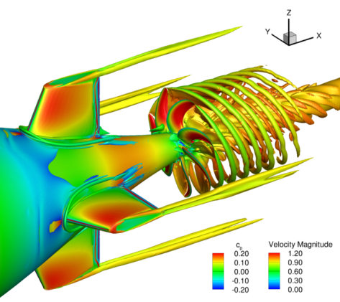
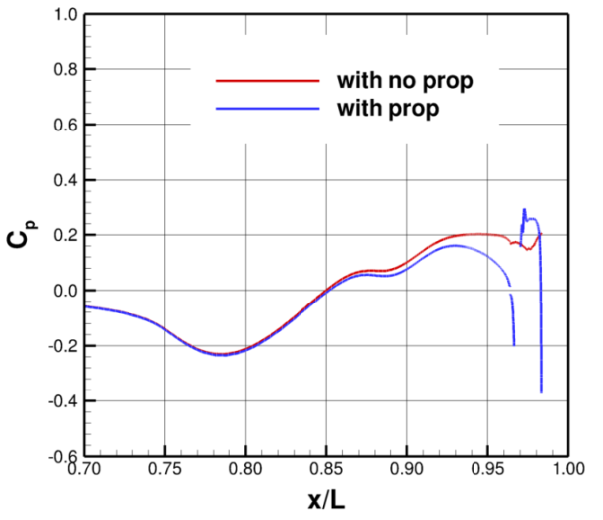
Example
Effects of a rotating propeller – Top left: iso-surface of Q colored by velocity magnitude; Top right: pressure coefficient (C_{P}) along the hull; Bottom left: resistance augmentation for a range of propeller loading β = 0°.

Slide 35
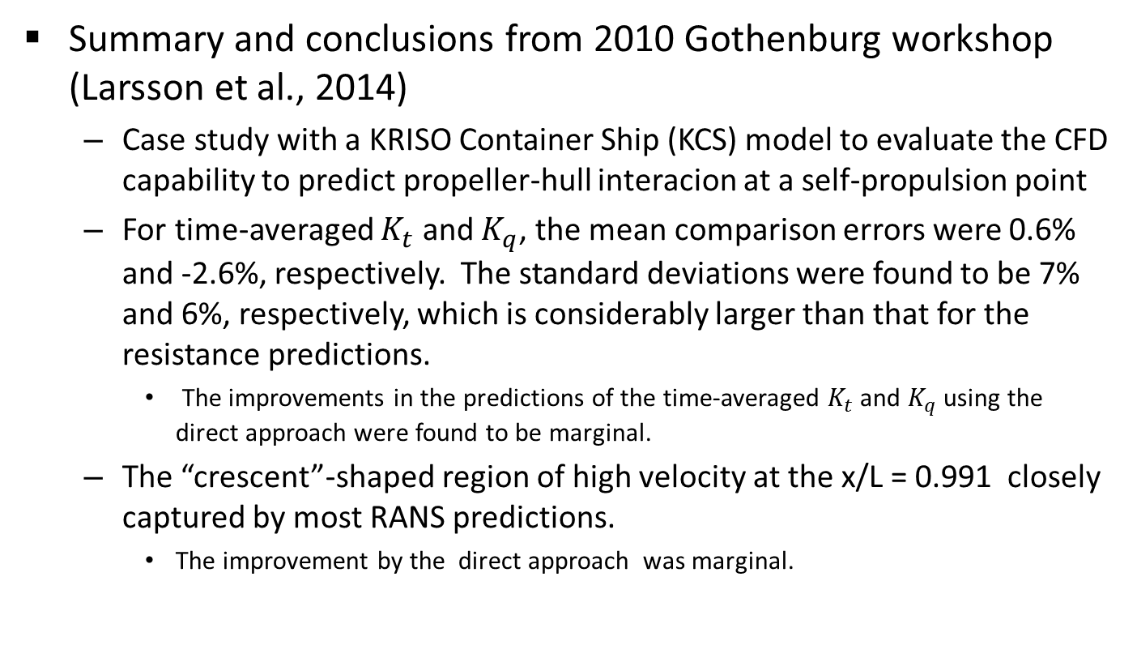
  Summary and conclusions from 2010 Gothenburg workshop (Larsson et al., 2014)
  Case study with a KRISO Container Ship (KCS) model to evaluate the CFD capability to predict propeller-hull interacion at a self-propulsion point
  For time-averaged $K_{t}$ and $K_{q}$, the mean comparison errors were 0.6% and -2.6%, respectively. The standard deviations were found to be 7% and 6%, respectively, which is considerably larger than that for the resistance predictions.
    The improvements in the predictions of the time-averaged $K_{t}$ and $K_{q}$ using the direct approach were found to be marginal.
  The “crescent”-shaped region of high velocity at the x/L = 0.991 closely captured by most RANS predictions.
    The improvement by the direct approach was marginal.

Slide 36
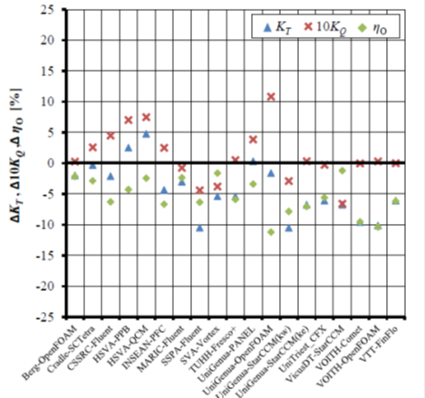
7.3 Propellers
CFD workshop
SMP-2011, a CFD-workshop of non-cavitating and cavitating flows.
Potsdam Propeller Test Case to compute: open water performance, velocity field and cavitation.
All viscous flow methods used were FV-methods.
Unstructured grids more popular than structured grids (10/3)
Multiple reference frames were more popular than sliding mesh techniques (9/3).
For cavitation modelling all groups used mass transfer models
An example about the relative
differences of open water
computed results

Slide 37
Examples
Muscari & Di Mascio (2013): “Detached Eddy Simulation of the flow behind an isolated propeller.”
Study of advantages and limits of eddy viscosity models and detached eddy simulations. Global quantities perform equally well. Local flow field better captured by DES, eddy viscosity models too dissipative.
Morgut & Nobile (2012). “Influence of grid type and turbulence model on the numerical prediction of the flow around marine propellers working in uniform inflow.”
Muscari & Di Mascio. J = 0.45. Section x-z of axial velocity. RANSE (top) and DES phase average (bottom.

Slide 38
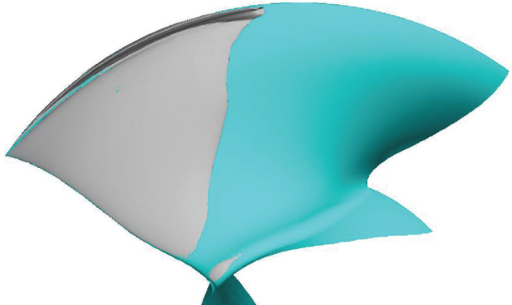
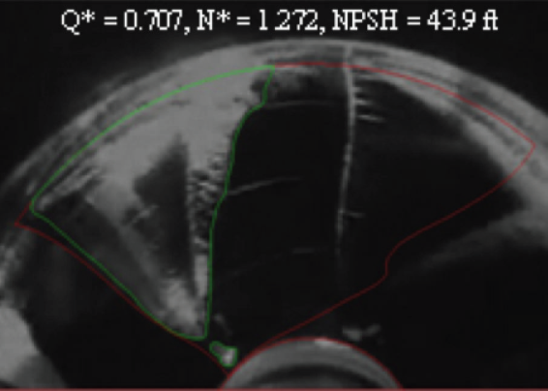
Examples
Lu et al. (2012): “Numerical Simulations of the Cavitating Flow on a Marine Propeller”
Three methods, from lifting surface and RANS to LES, were used to demonstrate the capability of different simulation tools for a 10 degree tilted marine propeller.
Lindau et al. (2012). “Modeling of Cavitating Flow throughWaterjet Propulsors”
The computational approach is useful and accurate when properly applied to the modeling of blade cavitation patterns and cavitation-driven thrust breakdown for axial flow waterjets
Lindau et al. Waterjet pump rotor suction-surface cavitation patterns. Results from RANS-based
modeling and photographs from testing.

Slide 39
Benchmark cases
INSEAN E779A
  Modified type Wageningen propeller, P/D = 1.1, D = 227.2 mm.
  Measurements of velocity field, radiated pressure field, cavitation patterns were performed in cavitation tunnel.
PPTC
  CP propeller, Z = 5, D = 250mm, P/D 1.57.
  Data: open water test, LDV velocity field measurements at several planes, cavitation tests at different operation conditions.
P5168
  CP propeller, Z = 5, D = 402.7 mm, P/D = 1.27.
  Examination of the behaviour of the tip-vortex flow. In addition full Reynolds stress tensor was measured for the primary advance coefficient.
AxWJ-2. Axial flow waterjet pump.
  Measurements of the total head rise and shaft torque of the pump .
  Flow conditions range up to cavitation breakdown.

Slide 40
7.4 Seakeeping
CFD tools are mature to provide accurate predictions for seakeeping related problems; two primary issues limit the widespread use of these methods:
CPU time requirements
  Not efficient for RAOs (unless a single run procedure (Mousaviraad et al. (2010)) is used (accurate for linear response))
  Irregular waves
Still relatively ineffective in simulating the disturbed ship waves in the far field domain
Nevertheless, the number of publications and submissions to workshops (e.g. Gothenburg 2010) is increasing.

Slide 41
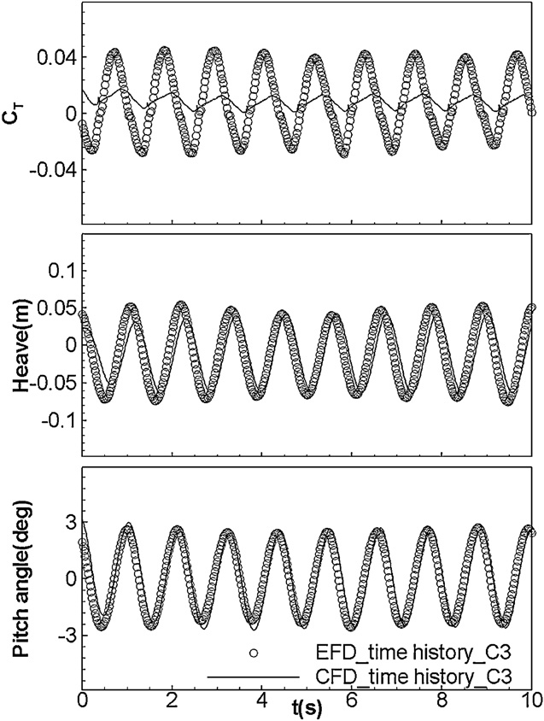
Recent Literature
Recent achievements/applications well summarized by G2010 workshop (Larsson et al. 2014):
3 hull forms, different conditions (including forward speed diffraction,
roll decay, prediction of motion and resistance
About 20 submissions from several institutions using different codes
Comparison (motions, forces, wave field and
nominal wake) general satisfacory agremeent:
Prediction of motion within 10%
Larger errors (even more than 20%) for added resistance
Lack in EFD UA estimation and facility bias
Example: Carrica et al. (2011)
KCS in head waves, self propelled, free sink and trim
Conclusions: good agreement for motions and 0th
harmonic of forces, high discrepancy amplitude and
1st harmonic amplitude and phase of the resistance forces
Carrica et al. (2011)

Slide 42
Benchmark and V&V
As already concluded by previous ITCC SCoCFD, validation data (including motion, forces and flow field) are still scarce, efforts:
EFD data from G2010 (issues with UA and facility bias) (Larsson (2014))
Delft catamaran (motions, resistance; TTT, regular and irregular waves)
(Broglia et al. (2011), Bouscasse et al. (2013))
AVT-NATO 216 group, which includes topics on maneuvering in waves
CRS group organized a workshop on seakeeping predictions for a number of
ships, experimental data includes motion and loads for several conditions
(wave length/amplitude, forward speed and wave direction) for two vessels
V&V is usually performed considering global quantities (first harmonic amplitudes and phases of motions and forces, see for example Larsson et al. 2014, Carrica et al. 2011).

Slide 43
7.5 Manoeuvering
Use of CFD tools for maneuvering simulation has become common
The level of geometrical details (movable appendages, propeller) and the inclusion of other important aspects considered (controllers, influence of air, breaking wave, air entrapment) has increased.
Still challenging due to CPU time requirements and numerical difficulties related to complex flow field phenomena (separation, air entrapment, propeller models, full scale Reynolds number)
Applications:
  Prescribed manoeuvers: estimation of derivatives for SB model
  Free running manoeuver, including manoeuvering in waves
Recent reviews: SIMMAN 2008 (Stern et al. 2011), G2010 (Larsson et al. 2014) and 29th ONR 2012 (Stern et al. 2012)

Slide 44
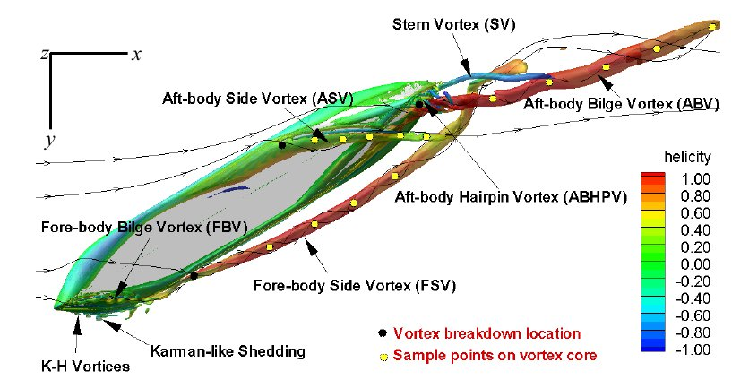
Manoeuvering: Examples
Prescribed manoeuvers
  Toxopeus et al. (2013), KVLCC2 in steady drift/turn (AVT-161 activity), with comparison between different institutes and several codes:
    Fine grids for low uncertainty: use of wall functions, AMR (Visonneau 2014)
    Turbulence model important role, advanced t.m. (EASM or ARS-DES) provide better results
    Better agreement and low uncertainty for steady drift deep water, larger errors/uncertainty for shallow water and non zero drift/turn
  Xing et al. (2012), KVLCC2 steady large drift angle:
    Prediction of onset and progression of
    large vortical structures
    Use of very refined grids
    Use of sophisticated t.m. (ARS-DES)
  Prescribed dynamic manoeuvers
  using virtual PMM
    E.g. Sakamoto et al. (2012), Mousaviraad (2012),
    Di Mascio et al. (2011), Simonsen et al. (2012)

Slide 45
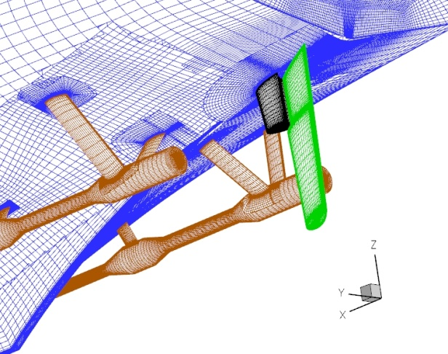
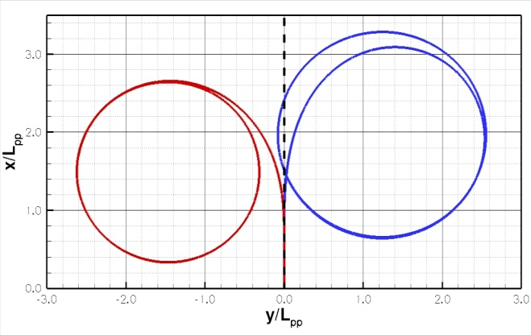
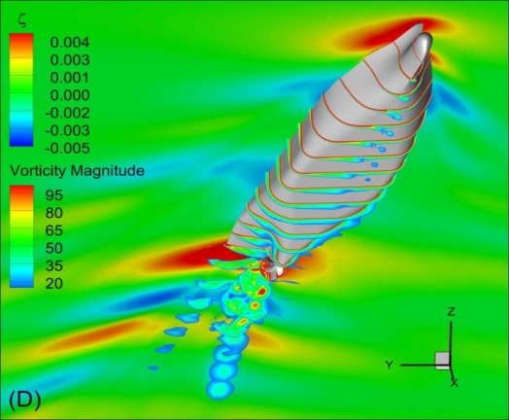
Manoeuvering: Examples
Predicted manoeuvers
Still challenging, special techniques required:
  Movable appendages (dyn. overset, sliding mesh)
  6DoF and propulsion (suitable model) capabilities
  Efficient HPC capabilities
Some examples:
  Turning circle maneuver twin screw (propeller
  model with lateral force), single and twin
  rudder Broglia et al. (2012)
  20/10 horizontal overshoot maneuver
  of a submarine with rotating
  propeller Chase et al. (2013)
  Zigzag maneuvers of KCS with rotating
  propeller Mofidi and Carrica (2014)
Broglia et al. (2012)
Twin rudder
Single rudder
Chase et al. (2013)
Mofidi and Carrica (2014)

Slide 46
Examples
Maneuvering in waves
Rather challenging, issues related to both seakeeping and free maneuvering simulations have to overcome
  Movable appendages, controllers
  6DoF and self propulsion capabilities
  Wave maker and boundary conditions
  Disturbing waves in the far field
Some examples:
  Surface combatant, turning circle in
  waves (Carrica et al. 2013)
  SES model in waves, modeled cushion
  pressure (Mousaviraad et al. 2012)
  Dynamic stability analysis of ONR
  Tumblehome, analysis of the
  mechanism of broaching in regular
  following waves (Carrica et al. 2012)
Carrica et al. (2012)

Slide 47
Benchmark and V&V
In recent years efforts to collect data have been accelerated, driven mainly from dedicated workshops (SIMMAN 2008 and upcoming SIMMAN 2014). Latest efforts:
Sanada et al. (2012), ONR tumblehome maneuvering in waves;
PIV velocity measurements:
  DTMB5415 PMM tests (Yoon (2009)), steady turn (Atsavapranee (2010)), roll decay (Irvine (2013)), steady drift (Egeberg (2014))
  Delft catamaran in steady drift (Broglia et al. (2011b))
No specific procedures are available for V&V. Issues and methodology:
Verification is challenging (definition of proper measures and grids in the asymptotic range)
Validation usually assessed for global quantities (trajectory and dynamic parameters) as, for example in Broglia et al. (2011) and Carrica et al. (2013)

Slide 48
7.6 Ocean Engineering
CFD use in Ocean Engineering
Limited to applications for which viscous flow effects are not negligible
  Free-surface flow around offshore structures
  Ocean renewable energy
  Fluid-structure interaction of ocean structures
  …
Although CFD applications increasingly popular, there is still a plenty of room for improvement, requiring extensive amount of research.

Slide 49
FPSO in waves
FPSO's generally operated in a specific region and positioned to meet mostly head or bow waves to reduce roll motions.
Lim et al. (2012)
  Experimental results for three different FPSO bow shapes in regular head waves.
  CFD computations carried out as a sample validation case for the database built for CFD code.
Kim (2011)
  2D floating body with a moon pool under forced heave motion. Dynamic CFD simulation carried out.
  Effects of vortex shedding and viscosity investigated by changing the corner shapes of the floating body.
  The flow fields analyzed to determine the mechanisms of wave elevation, damping, and sway force.

Slide 50
VIV of risers
Structures described by Lagrangian formulations, while fluids described by Eulerian formulations. Coupling requires tight integration of the two solvers.
Chen and Kim (2012)
  Dynamic effect of internal flow considering FSI for a marine riser in an external shear current.
Halkyard et al. (2006)
  Helical strakes were employed to mitigate VIM.

Slide 51
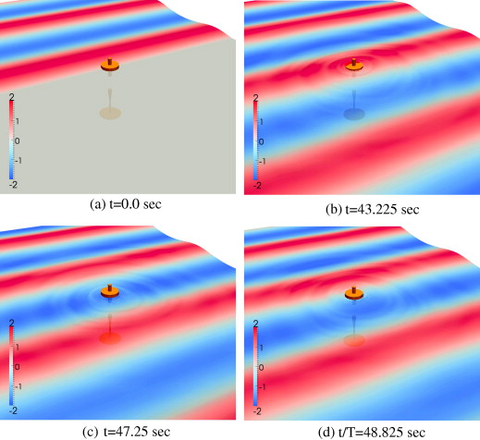
VIV of risers
Yu and Li (2013)
  Hydrodynamics performance of a floating-point absorber wave energy system
  Nonlinear effects, including wave-overtopping induced forces, are significant.

Slide 52
Marine renewable energy
Two computational procedures, based on the blade element momentum theory and CFD, developed for open water performance prediction of horizontal axis tidal stream turbines (Lee et al. 2012). Verified by comparison and applied to a turbine design process.

Slide 53
Benchmark cases
Wave run-up around an offshore structure
  The most widely accepted benchmark is the experimental data adopted by the 27th ITTC Ocean Engineering Committee.
  Free-surface behaviour around and pressure acting on a single truncated circular cylinder in waves.
  For various wave conditions, wave elevation ahead of and behind the cylinder, wave run-up and pressure on the cylinder were measured.
Horizontal axis tidal stream turbine
  Bahaj et al. (2007)
  A tidal stream turbine model of the most popular type was towed in a towing tank.
  The turbine’s performance was measured and compared with the one predicted by a theoretical formula.

Slide 54
V&V procedures and needs
V&V for CFD simulations of ocean engineering problems are still controversial.
Because of the unsteady nature of the problems, it is difficult to understand how to quantify errors in the more or less random temporal variations.
Moreover, full 6DOF motion in response to external environment is susceptible to various types of uncertainties.

Slide 55
Guidelines
7.5-03-02-03 Practical Guidelines for Ship CFD Applications. (Revised)
7.5-03-02-04 Practical Guidelines for Ship Resistance CFD. (New)
7.5-03-03-01 Practical Guidelines for Ship Self-propulsion CFD. (New)
7.5-03-03-02 Practical Guidelines for RANS Calculation of Nominal Wakes. (New)

Slide 56
7.5-03-02-03 Practical Guidelines for Ship CFD Applications.
1. INTRODUCTION
2. PRE-PROCESSING
2.1 Geometry
2.2 Computational Domain
and Boundary Conditions
2.3 Grid
3. COMPUTATION
3.1 Turbulence Models
3.2 Near-wall Modelling
3.3 Surface Roughness
3.4 Numerical Schemes
3.5 Free Surface
3.6 Time Step
3.7 Parallel Computing
3.8 Convergence
4. POST-PROCESSING
4.1 Visualization
4.2 Verification and
Validation
5. REFERENCES
REFERENCES TO OTHER
CFD GUIDELINE

Slide 57
7.5-03-02-04 Practical Guidelines for Ship Resistance CFD.
1. OVERVIEW
2. COMPUTATIONAL PROCEDURE
2.1 Preliminaries
2.2 CFD Code and Computer
2.3 Ship Geometry, Computational Domain, and Boundary Conditions
2.4 Computational Grid
2.5 Discretization Schemes and Solution Algorithms
2.6 Turbulence Modeling
2.7 Convergence of RANSE Solutions
3. ANALYSIS OF RESULTS
3.1 Resistance
3.2 Effective Power Estimation
3.3 Nominal Wake Fraction
3.4 Visualization
4. UNCERTAINTY ANALYSIS
5. REFERENCES
6. A TUTORIAL FROM THE G2010 WORKSHOP

Slide 58
7.5-03-03-01 Practical Guidelines for Ship Self-propulsion CFD.
1. OVERVIEW
2. SELF-PROPULSION
COMPUTATION
2.1 Propeller Implementation
2.2 Self-propulsion Computation
3. TOWED COMPUTATION
4. OPEN WATER CURVES
5. POST-PROCESSING
5.1 Computation of Self-Propulsion Factors
6. VERIFICATION AND
VALIDATION
7. USEFUL REFRENCES

Slide 59
7.5-03-03-02 Practical Guidelines for RANS Calculation of Nominal Wakes.
1. OVERVIEW
2. CHOICE OF MODEL OR FULL
SCALE
NOMINAL WAKE IN MODEL
SCALE
3.1 Pre-processing
3.2 Numerical Concerns
3.3 Post-processing
3.4 Verification and
Validation
4. REFERENCES

